Slide 1
Introduction to Java
Class 6:
Methods

Slide 2
Introduction
Suppose that you need to find the sum of integers from 1 to 10, from 20 to 37, and from 35 to 49, respectively. How would you do it?

Slide 3
Introduction
You may have observed that computing these sums from 1 to 10, from 20 to 37, and from 35 to 49 are very similar except that the starting and ending integers are different. Wouldn’t it be nice if we could write the common code once and reuse it? We can do so by defining a method and invoking it.

Slide 4
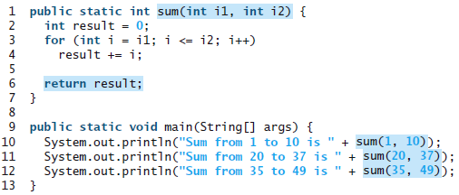
Introduction

Slide 5
Defining a Method
A method definition consists of its method name, parameters, return value type, and body.
modifier returnValueType methodName(list of parameters) {
// Method body;
}

Slide 6
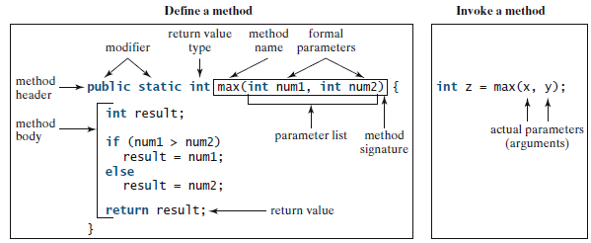
Defining a Method

Slide 7
Defining a Method
Some programming languages refer to methods as procedures and functions. In those languages, a value-returning method is called a function and a void method is called a procedure.

Slide 8
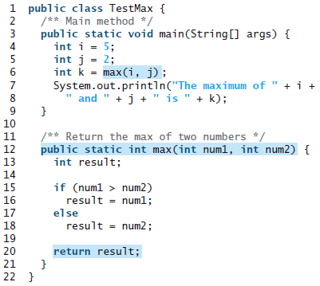
Calling a Method

Slide 9
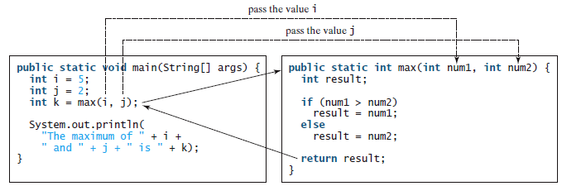
Calling a Method

Slide 10
void Method
void Methods don’t return a value.

Slide 11
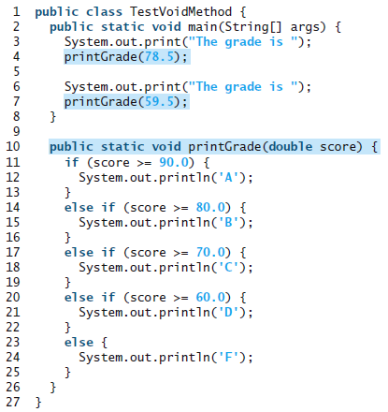
void Method

Slide 12
void Method

Slide 13
Exercise 1
Create a program that calculates the addition, subtraction, multiplication and division of two numbers using methods for each operation. Create a menu for your program.

Slide 14
Exercise 2
Using the previous program, modify it so that the program doesn’t end until the user wants to close it. Hint: create a void method for a menu, use loops.

Slide 15
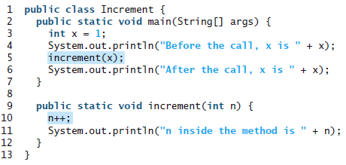
Passing Parameters By Value

Slide 16
Passing Parameters By Value
Create a program that calculates the great common divisor using methods.

Slide 17
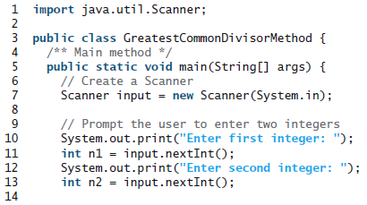
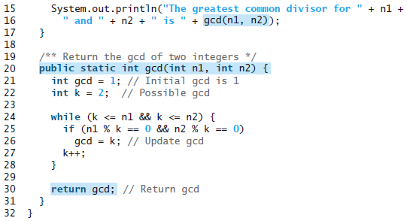
Passing Parameters By Value

Slide 18
Case Study: Decimal to Hex
Divide 123 by 16. The remainder is 11 (B in hexadecimal) and the quotient is 7. Continue to divide 7 by 16. The remainder is 7 and the quotient is 0. Therefore 7B is the hexadecimal number for 123.

Slide 19
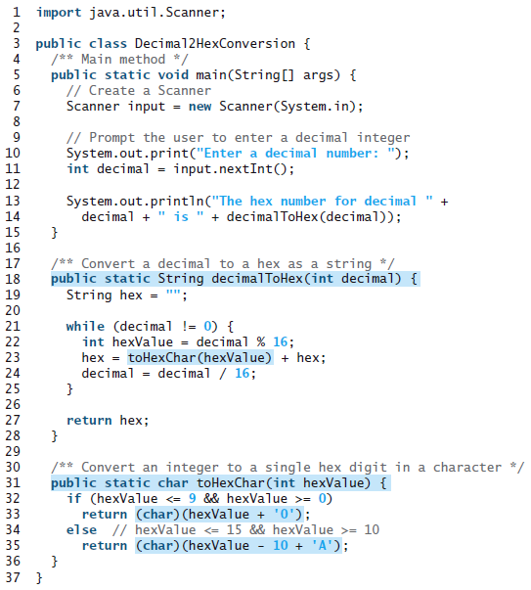

Slide 20
Overloading Methods
Overloading methods enables you to define the methods with the same name as long as their signatures are different. For example, you can write a method to sum three numbers in addition to the one that adds two numbers.

Slide 21
